Slide 1
Evidence and Evaluation
William M.K. Trochim
Presentation to the
Australasian Evaluation Society
International Conference
Canberra, Australia
2 September, 2009

Slide 2
Overview – Some Questions About Evidence
Where did this evidence movement come from?
Why is there so much emphasis on it today?
What is the relationship among evidence-based practice, practice-driven evidence and research-practice integration?
What constitutes evidence and how do we know it when we see it?
What is the “unit” of evidence?
How is evidence stored, retrieved and disseminated?

Slide 3
Overview – Some Questions About Evidence
How do we determine the quality of evidence?
What role do methods play in determining quality of evidence?
How does the move to an evidence focus influence our thinking about evaluation?
What role can evaluation play in generating or creating evidence and in influencing this movement?
What role should evidence play in influencing evaluation?

Slide 4
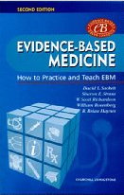
Where did this evidence movement come from?
Origins in in biomedical research – evidence-based medicine
Sackett (2000) played a leading role in the development of evidence-based medicine. He describes four reasons for its development:
The need for clinicians to have immediate information based on evidence
The inadequacy of existing sources
Out of date textbooks
Frequently wrong experts
Ineffective medical education
Overwhelming research literature
The decline in up-to-date knowledge as clinicians move past medical school days
Time pressures of treating patients immediately
Notes:
Origins in biomedical research
Some say (Sackett, 2000, p. 2) that the origins go back to ancient Chinese medicine and the method of “kaozheng” (which might be translated as “practicing evidential research”).
The original work emerged in 1992 by a group at MacMaster University in Canada led by Gordon Guyatt
Sackett played a leading role in the development of evidence-based medicine. He describes four reasons for its development:
The need for clinicians to have immediate information based on evidence
The inadequacy of existing sources
Out of date textbooks
Frequently wrong experts
Ineffective medical education
Overwhelming research literature
The decline in up-to-date knowledge as clinicians move past medical school days
Time pressures of treating patients immediately

Slide 5
Where did this evidence movement come from?
Meta-analysis in medicine
Extension to Public Health
Systematic Reviews
Extension to Social Programs
Guidelines
Extension to Education
Comparative Effectiveness Reviews (AHRQ)
Notes:
Origins in biomedical research
Some say (Sackett, 2000, p. 2) that the origins go back to ancient Chinese medicine and the method of “kaozheng” (which might be translated as “practicing evidential research”).
The original work emerged in 1992 by a group at MacMaster University in Canada led by Gordon Guyatt
Sackett played a leading role in the development of evidence-based medicine. He describes four reasons for its development:
The need for clinicians to have immediate information based on evidence
The inadequacy of existing sources
Out of date textbooks
Frequently wrong experts
Ineffective medical education
Overwhelming research literature
The decline in up-to-date knowledge as clinicians move past medical school days
Time pressures of treating patients immediately

Slide 6
Why is there so much emphasis on it today?
“Before the move toward evidence-based practice, medical textbooks and articles were filled with thousands of statements and care recommendations that were based solely on the belief of the author or at best a consensus of experts.”
(IOM, 2008, p123)
Overwhelming evidence base
Evidence that evidence was not being used in practice
Tensions between research and practice models
The ever-present pressure for accountability
The need to control quality of treatment
Notes:
Why the emphasis on evidence?
The overwhelming evidence base (at any given time there are thousands of clinical trials going on)
“Before the move toward evidence-based practice, medical textbooks and articles were filled with thousands of statements and care recommendations that were based solely on the belief of the author or at best a consensus of experts.” (IOM, 2008, p123)
There is evidence that evidence was not being used in practice
Tensions between research and practice models
The ever-present pressure for accountability
The desire for control mechanisms (e.g., there is a considerable danger that health regulation agencies and insurers use the evidence-based movement as a way to regulate service)

Slide 7
What is the relationship among evidence-based practice, practice-driven evidence and research-practice integration?
evidence
practice
evidence
practice
evidence
practice
Notes:
My experience in teaching EBP was that there was a conflict between two models – one from research→practice and the other from practice→research
Evidence-based medicine and evidence-based practice – driven from evidence to practice
Practice-driven evidence - The counter-argument is that evidence needs to be driven by the practice need and that needs to drive the search for evidence (the researcher-practitioner model; the dominance of the clinician and clinical expertise/judgment)
Research-Practice Integration – the inevitable synthesis; the recognition that there needs to be a dynamic mutually-informing relationship
This connects with the move toward “systems thinking” in health and medicine (ISIS, the move to systems evaluation in our field – Bob William’s pioneering work, Michael Patton’s 4th Edition of UFE)
Also connects with the idea of translational research – how do we move research to practice more effectively
My experience
I taught a course in evidence-based practice and used as one of the texts a very nice book by Gibbs (Gibbs, L. E. (2003). Evidence-based practice for the helping professions. Pacific Grove, CA: Thomson, Brooks-Cole.). He starts from the perspective of a medical practitioner who needs to have information to make a clinical decision – practice driving toward evidence. This is very different from what I had originally thought EBP was,
Evidence-Based Practice
Evidence-based practice (EBP) is one attempt at unifying the worlds of research and practice. Originating in medicine (Antes, 1998; Sackett, 1997) and now migrating to many other fields (Banerjee & Dickinson, 1997; Brownson, Baker, Leet, & Gillespie, 2002; Eitel & Steiner, 1999; Gibbs, 2003; Mupparapu, 2002), EBP is grounded in the idea that programs that have a strong evidence-base demonstrating their effectiveness should be disseminated and implemented. Evidence-based practice unites the worlds of research and practice by helping to ensure that practice is informed by research knowledge. However, EBP tends to be framed primarily from a researcher not a practitioner perspective and prioritizes knowledge generation over practical problems and precision and control over generalizability and diffusion (Green, 2007).
Practice-Based Evidence
A more recent response to the disproportionate balance between researcher versus practitioner generated knowledge inherent in evidence-based practice has been the discussion and promotion of what can be termed practice-based evidence (Green, 2006; McDonald & Viehbeck, 2007; Westfall, Mold, & Fagnan, 2007). According to this approach, research agendas are derived from and responsive to the needs identified in practice. Here, the impetus for knowledge acquisition consists of the questions raised by the practitioners that have daily experience interacting with clients, identifying needs, and generating “theories” of best practice.
Translational Research
While the goal of both evidence-based practice and practice-based evidence is the integration of research and practice, these approaches have, thus far, failed to adequately unite the two since they lack a clear bi-directional process that does not privilege one over the other. Like EBP, translational research (Dougherty & Conway, 2008; Khoury et al., 2007; Sung et al., 2003; Westfall et al., 2007; Woolf, 2008) – which has been widely applied in biomedicine, mental health and public health – attempts to bridge the gap from bench to bedside or from research to practice. There is broad consensus in the literature that translational research is bidirectional and dynamic in nature (Busse & Fleming, 1999; Cesario, Galetta, Russo, Margaritora, & Granone, 2003; Horig & Pullman, 2004; Ter Linde & Samsom, 2004; Westfall et al., 2007). While translational research has made great strides toward integrating basic research with clinical practice, the advances have primarily been anchored in the biomedical world and are focused on treating the individual in a clinical setting - exemplified by the phrase “bench to bedside”. Similar advances have yet to be made for programs in non-clinical settings (e.g., community-based or school-based programs) or for programs that emphasize behavior change and/or education.
Antes, G. (1998). Evidence-based medicine. Internist, 39(9), 899-908.
Banerjee, S., & Dickinson, E. (1997). Evidence based health care in old age psychiatry. International Journal of Psychiatry in Medicine, 27(3), 283-292.
Brownson, R. C., Baker, E. A., Leet, T. L., & Gillespie, K. N. (Eds.). (2002). Evidence-Based Public Health: Oxford University Press.
Busse, R., & Fleming, I. (1999). A critical look at cardiovascular translational research. American Journal of Physiology, 277(5 Pt 2), H1655-1660.
Cesario, A., Galetta, D., Russo, P., Margaritora, S., & Granone, P. (2003). The role of the surgeon in translational research. Lancet, 362(9389), 1082.
Dougherty, D., & Conway, P. H. (2008). The "3T's" road map to transform US health care. JAMA, 299(19), 2319 - 2321.
Eitel, F., & Steiner, S. (1999). Evidence-based learning. Medical Teacher, 21(5), 506-512.
Gibbs, L. E. (2003). Evidence-based practice for the helping professions. Pacific Grove, CA: Thomson, Brooks-Cole.
Green, L. (2006). Public health asks of systems science: To advance our evidence-based practice, can you help us get more practice-based evidence? American Journal of Public Health, 96(3), 406-409.
Green, L. (2007). The prevention research centers as models of practice-based evidence: Two decades on. American Journal of Preventive Medicine, 33(1S), S6-S8.
Horig, H., & Pullman, W. (2004). From bench to clinic and back: Perspective on the 1st IQPC Translational Research conference. Journal of Translational Medicine, 2(1), 44.
Khoury, M. J., Gwinn, M., Yoon, P. W., Dowling, N., Moore, C. A., & Bradley, L. (2007). The continuum of translation research in genomic medicine: How can we accelerate the appropriate integration of human genome discoveries into health care and disease prevention? Genetics in Medicine, 9(10), 665-674.
McDonald, P.W. & Viehbeck, S. (2007). From evidence-based practice making to practice-based evidence making: Creating communities of (research) and practice. Health Promotion Practice, 8(2), 140-144.
Mupparapu, M. (2002). Evidence-based dentistry. Oral Surgery Oral Medicine Oral Pathology Oral Radiology and Endodontics, 94(1), 2-3.
Sackett, D. L. (1997). Evidence-based medicine. Seminars in Perinatology, 21(1), 3-5.
Sung, N. S., Crowley, W. F. J., Genel, M., Salber, P., Sandy, L., Sherwood, L. M., et al. (2003). Central challenges facing the national clinical research enterprise. JAMA, 289(10), 1278-1287.
Ter Linde, J. J. M., & Samsom, M. (2004). Potential of genetic translational research in gastroenterology. Scandinavian Journal of Gastroenterology, 39, 38-44.
Westfall, J. M., Mold, J., & Fagnan, L. (2007). Practice-based research - "Blue Highways" on the NIH roadmap. Jama, 297(4), 403-406.
Woolf, S. H. (2008). The meaning of translational research and why it matters. Jama, 299(2), 211-213.

Slide 8
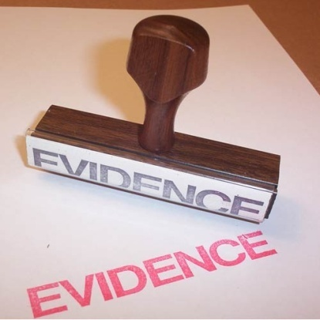
What constitutes evidence and how do we know it when we see it?
Evidence is synthesized empirical knowledge that can be understood and used by practitioners
Evidence differs in quality and most evidence-based systems use an evidence hierarchy – to help practitioners judge credibility
Evidence differs in strength of recommendation for practice and most evidence-based systems rate this
Notes:
While it may be that individual studies can constitute evidence, there is a growing consensus that individual studies are fallible and that we need to rely on multiple studies to provide credible evidence
Think of the analogy to law. The lawyer uses multiple “bits” of evidence to “make the case.” It is the amalgamation of the evidence – it’s synthesis – that is essential to making the case, not just any bit of evidence.
The other profoundly important aspect of this is that there is a jump in scale that occurs in the production of high-quality evidence. That is, we are no longer operating at the level of individual studies.
Also, there is consensus that it is not enough just to produce synthesized empirical knowledge – it needs to be in a form that can be understood and is accessible to practitioners

Slide 9
Two models of research – practice process
Basic
research
Clinical
research
Dissemination
Use
Impact
Research
Synthesis
Dissemination
Use
Impact
Basic
research
Clinical
research
Evidence involves a jump in “scale” from individual studies to synthesized knowledge
Basic
research
Clinical
research
Basic
research
Clinical
research
Basic
research
Clinical
research
Basic
research
Clinical
research
Notes:
There are two major ways to look at the research-to-practice process.
The traditional way moves from basic to clinical research which then gets disseminated andf used and ultimately has outcomes and impacts
The evidence-based model emphasizes the synthesis of lots of individual research. It is the synthesis which is thought to be of higher quality and therefore stronger for dissemination and use in order to influence impact
From a systems perspective what we have here is a jump in the level of “scale” or level of “generality” from individual studies to “synthesized empirical knowledge”

Slide 10
What is the “unit” of evidence and how is evidence stored, retrieved and disseminated?
“Units” of Evidence
Meta-analysis
Quantitative synthesis of the results of multiple research study results in order to arrive at an estimate of the average effect size across studies.
Systematic review
A synthesis that uses systematic methods to identify, select, assess and summarize findings across similar but separate studies. A systematic review may or may not include a meta-analysis.
Guideline
Practice recommendations developed systematically by a panel of experts who have access to the evidence, an understanding of the practice problem, knowledge of research methods, and time to absorb the information and make considered judgments.
Comparative effectiveness review
A type of systematic review that depicts how the relative benefits and harms of a range of practice options compare in the context of real-world practice. They answer more than the narrow question of whether a single therapy is safe and effective.
Notes:
The unit of evidence is usually a research synthesis
Meta-analysis – def based on IOM, 2008
systematic review - def based on IOM, 2008
Guideline - def based on IOM, 2008
comparative effectiveness review – “A Comparative Effectiveness Review (CER) is a unique type of the Effectiveness Review (systematic review) that depicts how the relative benefits and harms of a range of clinical options compare in the context of real-world healthcare decisions. They answer more than the narrow question of whether a single therapy is safe and effective. In the absence of head-to-head trials, Comparative Effectiveness Reviews may use indirect comparisons following explicit methodological criteria. The CER compares the tradeoffs of multiple alternatives each of which may vary with the underlying population and setting. CERs adhere to the same rigorous criteria by which all systematic reviews must follow.” (effectivehealthcare.ahrq.gov)
seldom is an individual study considered evidence – you need to “make a case”

Slide 11
What is the “unit” of evidence and how is evidence stored, retrieved and disseminated?
Storage
Notes:
Evidence is stored in electronic databases (usually web-based)
Cochrane
Community Guide
Guidelines.gov
Etc.
Retrieval depends on access at the time and point of need – a major problem/challenge – some databases require licensed access (e.g., Cochrane)
Dissemination is a huge issue. We know that only a small percent of practitioners in medicine use

Slide 12
How do we determine the quality of evidence?
“Numerous hierarchies and typologies have proliferated – each with its own system of letters, codes and symbols (Schunemann, 2003). …the end result is greater confusion rather than clarification.” (IOM, 2008, p. 102)
“Evidence hierarchies have helped raise awareness that some study designs are less subject to bias than others (Glasziou et al, 2004). Hierarchies, however, consider just the type of research study (e.g., RCTs or prospective observational studies) and not the quality of the individual studies (Poolman et al, 2006). Findings from a poorly conducted trial should not necessarily trump evidence from a nonrandomized study.” (IOM, 2008, p.102)
Notes:
“Numerous hierarchies and typologies have proliferated – each with its own system of letters, codes and symbols (Schunemann, 2003). …the end result is greater confusion rather than clarification.” (IOM, 2008, p. 102)
“Evidence hierarchies have helped raise awareness that some study designs are less subject to bias than others (Glasziou et al, 2004). Hierarchies, however, consider just the type of research study (e.g., RCTs or prospective observational studies) and not the quality of the individual studies (Poolman et al, 2006). Findings from a poorly conducted trial should not necessarily trump evidence from a nonrandomized study.” (IOM, 2008, p.102)

Slide 13
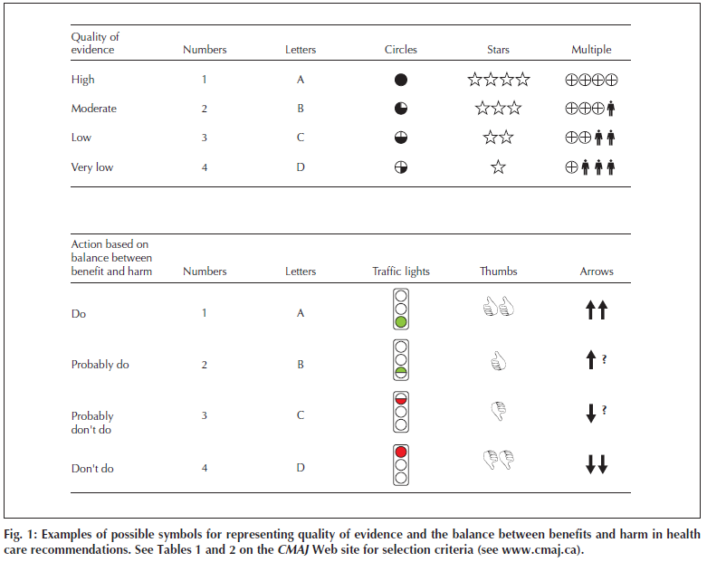
How do we determine the quality of evidence?
From Schunemann, H.D., Best, G. Vist, G. and A.D. Oxman. 2003. Letters, numbers, symbols and words: How to communicate grades of evidence and recommendations. Canadian Medical Association Journal, 169(7): 677-680.
Notes:
Here’s an example of a table that illustrates the structure of many hierarchies. There is usually a system of grading the quality of the evidence that is linked primarily to the type of research design used, and then there is usually some way of grading how much the evidence should be used or trusted in practice.

Slide 14
What role do methods play in determining quality of evidence?
Methodological
Pluralist Pragmatists
Experiment as “Gold Standard”
Views on Evidence Hierarchies

Slide 15
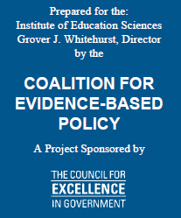
RCT “Gold Standard” View of Evidence Hierarchy
“Well-designed and implemented randomized controlled trials are considered the “gold standard” for evaluating an intervention’s effectiveness, in fields such as medicine, welfare and employment policy, and psychology.”
(U.S. D.O.E., 2003), p. 1. (emphasis added)
Notes:
Note the reference to medicine.

Slide 16
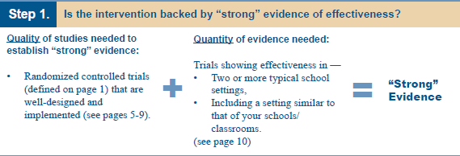
RCT “Gold Standard” View of Evidence Hierarchy
U.S. Department of Education, (2003). Identifying and implementing educational practices supported by rigorous evidence: A user friendly guide. Washington, D.C., p. v.

Slide 17
RCT “Gold Standard” View of Evidence Hierarchy
U.S. Department of Education, (2003). Identifying and implementing educational practices supported by rigorous evidence: A user friendly guide. Washington, D.C., p. v.
Notes:
Note especially the wording of Step 3. They’ve moved from talking about “strong” evidence above to now talking about “meaningful” evidence. If science had adopted this type of criterion generally much of what we regard as the most meaningful science in history would be ruled out!

Slide 18
RCT “Gold Standard” View of Evidence Hierarchy
“The revised PART guidance this year underscores the need for agencies to think about the most appropriate type of evaluation to demonstrate the effectiveness of their programs. As such, the guidance points to the randomized controlled trial (RCT) as an example of the best type of evaluation to demonstrate actual program impact. (emphasis added) Yet, RCTs are not suitable for every program and generally can be employed only under very specific circumstances. Therefore, agencies often will need to consider alternative evaluation methodologies. ” (p. 1)
Well-designed and implemented RCTs are considered the gold standard (emphasis added) for evaluating an intervention’s effectiveness across many diverse fields of human inquiry, such as medicine, welfare and employment, psychology, and education. (p. 4).”
OMB PART Evaluation Guidance written by
The Coalition for Evidence-Based Policy
the guidance points to the randomized controlled trial (RCT) as an example of the best type of evaluation to demonstrate actual program impact.
RCTs are considered the gold standard
Notes:
Note the reference to medicine.

Slide 19
Pluralist Pragmatist View of Evidence Hierarchies
“RCTs can answer questions about the efficacy of screening, preventive, and therapeutic interventions… Observational studies are generally the most appropriate for answering questions related to prognosis, diagnostic accuracy, incidence, prevalence, and etiology (Chou and Helfand, 2005; Tatsioni et al., 2005). Cohort studies and case series are useful for examining long-term outcomes because RCTs may not monitor patients beyond the primary outcome of interest or for rare outcomes because they generally have small numbers of participants. Case series are often used, for example, to identify the potential long-term harms of new types of radiotherapy. Similarly, the best evidence on potential harms related to oral contraceptive use (e.g., an increased risk of thromboembolism) may be from nonrandomized cohort studies or casecontrol studies (Glasziou et al., 2004).” (IOM, 2008, p. 91)

Slide 20
Pluralist Pragmatist View of Evidence Hierarchies
Randomized control group trials (RCTs) are not the only studies capable of generating understandings of causality.
RCTs are not always best for determining causality and can be misleading.
RCTs should sometimes be ruled out for reasons of ethics.
In some cases, data sources are insufficient for RCTs. Pilot, experimental, and exploratory education, health, and social programs are often small enough in scale to preclude use of RCTs as an evaluation methodology, however important it may be to examine causality prior to wider implementation.
Actual practice and many published examples demonstrate that alternative and mixed methods are rigorous and scientific.
American Evaluation Association Response To U. S. Department of Education Notice of proposed priority, Federal Register RIN 1890-ZA00, November 4, 2003 "Scientifically Based Evaluation Methods." http://www.eval.org/doestatement.htm

Slide 21
Pluralist Pragmatist View of Evidence Hierarchies
While we appreciate the value of experimental designs as an evaluation method, we believe that a judgment of “best,” as specified in the proposed language, does not adequately account for other methods of evaluation that might be as or more appropriate depending on the specific education program.
American Educational Research Association, (2003). Resolution on the Essential Elements of Scientifically-based Research. http://www.eval.org/doeaera.htm

Slide 22
Pluralist Pragmatist View of Evidence Hierarchies
RCTs are weak with respect to the goal of program improvement.
RCTs do not by themselves explicitly address construct validity.
RCTs are weak with respect to generalizability or external validity.
Addressing RCTs’ validity problems often entails investment in companion program evaluations that have methodological designs other than RCTs.
The importance of mixed methods.
The need to address feasibility and resource issues realistically.
The need to address equity and human subjects concerns realistically.
Evaluation Policy Task Force (2008). Comments on What Constitutes Strong Evidence of a Program’s Effectiveness? American Evaluation Association. http://www.eval.org/aea08.omb.guidance.responseF.pdf

Slide 23
Reformulating the Evidence Hierarchy Debate
This struggle has been difficult
It doesn’t need to be this hard
The danger right now is overadvocacy of RCTs as the basis of evidence
The problem is not whether to use RCTs, it’s when they should be used in the life of a program
Or in other words a major problem is…
Premature Experimentation

Slide 24
How does the move to an evidence focus influence our thinking about evaluation?
Suggests that we need a reframing of evaluation
Premise: a fundamental problem with the overadvocacy of RCTs is that the proponents have only selectively adopted what makes the biomedical research model so effective
They have adopted the emphasis on RCTs as a scientifically rigorous way to assess program effectiveness
But they have not adopted the entire supporting system that has made that possible
The supporting system of evidence norms and phased trials that provide a necessary foundation for RCTs
There is a scientific rigorous basis for adopting this broader system that preserves a central role for RCTs but puts them in their appropriate place in the larger evidence-generating endeavor…

Slide 25
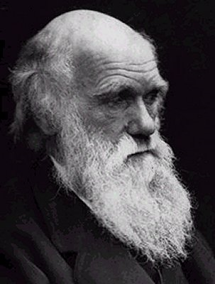
A Potential Reframing
An evolutionary systems thinking approach
Phylogeny
Programs evolve just like species.
Blind variation and selective retention of those with “fitness to environment.
Symbiosis and Co-Evolution
Programs and their evaluation need to be linked appropriately. The right evaluation method for the right stage of development
Ontogeny
Programs change through a life-course.
They grow through different stages.
Notes:
Need to adopt an evolutionary model
This is one of the strongest most scientifically rigorous frameworks we can adopt – a stronger and even more defensible basis than the argument for RCTs alone
Phylogeny – the evolution of programs is like the evolution of species. BVSR. Meta-analysis is a type of selection mechanism. This they get in education.
Ontogeny – the idea of a “life course”. Biomedicine gets this – the multi-phased clinical trial. You cannot adopt the biomedical model of evidence-based practice and only adopt the phylogenetic part of it – you also need to adopt the ontogenic part.
Symbiosis – the key is to synchronize the program life-cycle phase with the evaluation method

Slide 26
Adopting a Phased Approach to Evidence
“Clinical trials involve four basic phases.
Phase I trials are exploratory small sample studies that examine tolerance of the treatment and potential side effects.
Phase II trials typically demonstrate whether the program is capable of achieving effects (efficacy) and examines its correlates.
Phase III trials are typically controlled effectiveness studies.
Phase IV trials typically examine generalizability and the fidelity of transfer of controlled interventions to field settings.
Randomized designs are usually not used until late in phase II or more likely in phase III studies when effectiveness is the focus. The FDA reports that the vast majority of interventions (approximately 70-75%) that begin clinical trials do not survive to controlled Phase III randomized trials because they do not meet the basic conditions that warrant subsequent efforts.”
We need clear criteria that must be met before RCTs are mounted
Evaluation Policy Task Force (2008). Comments on What Constitutes Strong Evidence of a Program’s Effectiveness? American Evaluation Association. http://www.eval.org/aea08.omb.guidance.responseF.pdf

Slide 27
Some Potential Requirements for an RCT
the program is well defined and has an articulated program model
the program has been implemented consistently and with high fidelity
there are high-quality (e.g., valid and reliable) outcome measures
the program as implemented is capable of producing change
there is sufficient statistical power to accomplish the study with high quality
the participants can be kept unaware of the group (intervention or control) to which they have been assigned
the random assignment can be implemented and maintained
ethical and human subject protections have been approved and are in place
Evaluation Policy Task Force (2008). Comments on What Constitutes Strong Evidence of a Program’s Effectiveness? American Evaluation Association. http://www.eval.org/aea08.omb.guidance.responseF.pdf
Notes:
There will still be a critical role for RCTs
We need scientifically rigorous criteria for determining when an RCT should be allowed to go forward!!!

Slide 28
Need for an Evidence Generation Culture
Practitioners (program managers, deliverers and advocates) need to know that
Only a few programs should survive in the long run
It is our job to consciously evolve programs and variations (artificial selection as opposed to natural selection)
We need to consciously move programs through developmental stages (too much arrested development!)
Anticipate and plan for next stages
We succeed – we are doing our jobs – when we engage in this process, even if our program “fails”
Institutions and organizations need to provide expectations and incentives to support these norms
Decision makers and funders need to understand the game we’re in
Notes:
This culture change will not be easy, but it can be done

Slide 29
What role does evaluation play in generating or creating evidence and in influencing this movement?
Intervention trials to generate evidence are evaluation research
Evaluation for understanding the process of research-practice integration and translation (moving from research → synthesis → use)
Evaluation can help assess dissemination approaches
Evaluation as a profession can add a measured voice to the debates about evidence, especially with respect to methods. We can and should help shape policies about evidence generation.
Notes:
Intervention trials can be considered a form of evaluation research
Evaluation can be useful in understanding the process of moving from research to synthesis to use
Give the example of the Cochrane results I’m working on
Evaluation can help us assess interventions designed to enhance dissemination
For instance, the Botvin evaluation of LST
There is a recognition that we need to do more than “build it” in order to get people to come
Evaluation as a profession can add a measured voice to the debates about evidence, especially with respect to methods. That is, we can and should help shape policies about evidence generation.
The AEA EPTF response to OMB (provide some good quotes)
The AEA EPTF Evaluation roadmap (provide some good quotes)

Slide 30
What role should evidence play in influencing evaluation?
Practice what we preach!
Develop an evaluation evidence-base
Emulate the full evolutionary model to study what works in evaluation
Example – NSF project to develop and test a systems evaluation approach to planning, implementing and utilizing evaluations
Purpose – develop a systems thinking approach to evaluation
Program – partnerships, protocol, cyberinfrastructure
Phase I – development and formative/process evaluation (2006 – 2008)
Phase II – efficacy studies – is the approach correlated with key outcomes (2008 – 2013)
Phase III – effectiveness studies – a national or even international cross-site implementation (2013 – 2018)
Phase IV – dissemination studies

Slide 31
Conclusions
Evaluation needs to understand the evidence movement and actively shape it based upon our experience
Evaluation should embrace an evolutionary, ecological, systems-oriented perspective
It is based on a solid scientific foundation (there’s almost no stronger theory out there than evolution!)
It provides a framework for viewing an evaluation as contributing to a broader evolution of knowledge
It provides a rationale for why multiple and different methods are needed throughout the life of an intervention
It provides an appropriate role for RCTs
Evaluation needs to develop our own evidence base and model these values

Slide 32
Conclusions
There are many other questions we need to address…
How can an emphasis on evidence be misused?
When have we gathered enough evidence?
How do we determine the balance of what types of evidence we need?
How do we allocate resources for evidence generation and use?
How do we train the next generation of researchers, evaluators, decision-makers and practitioners?
How do we educate the public about evidence?
We have a lot of work to do!

